Slide 1
Topic in NLP:
Deeper Exploratory of Text Data in the Hotel Industry
Gezheng Bai, Jiaxin Zhou, Minxing Sun, Yijie Yang

Slide 2
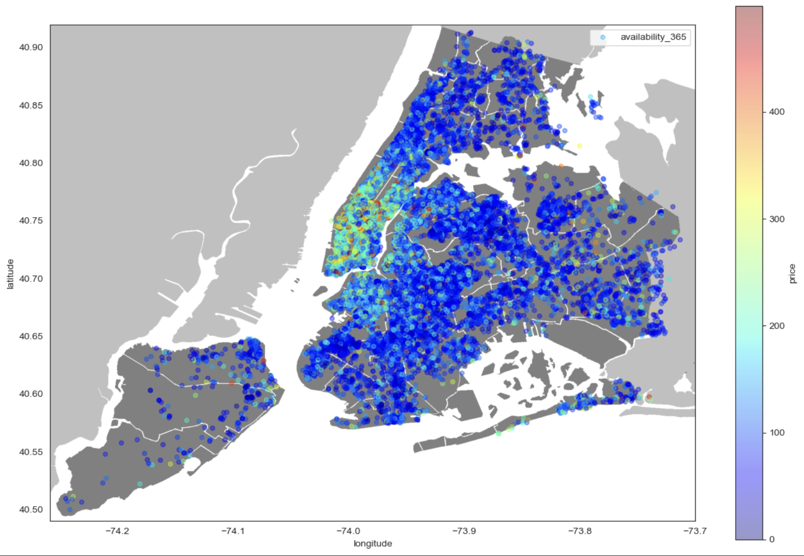
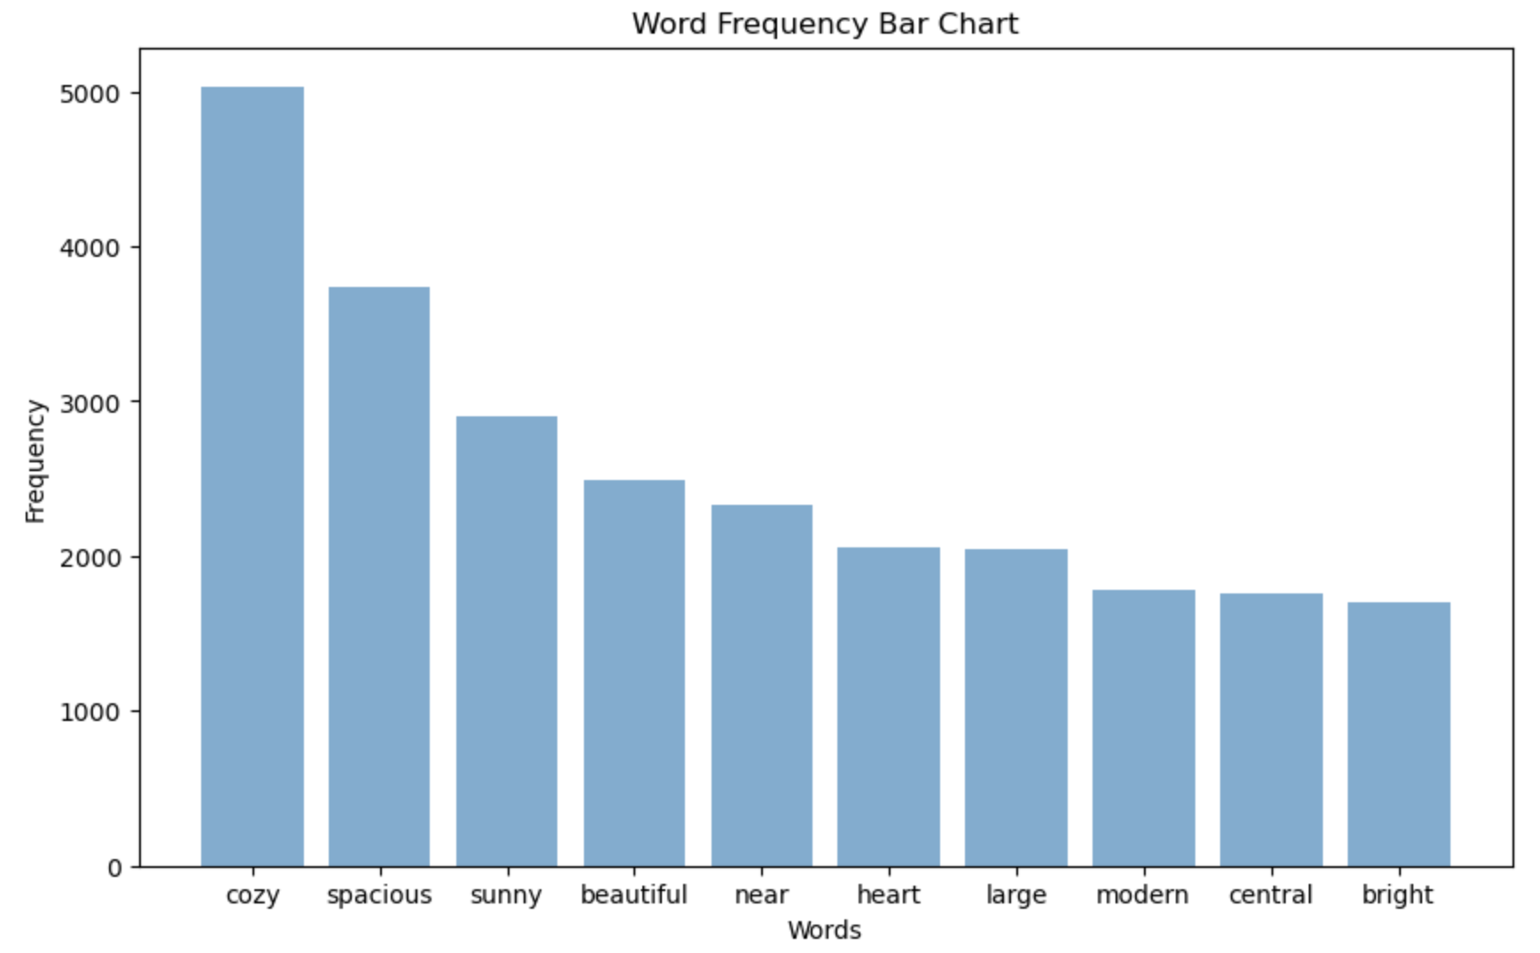
Summary for project 1: 2019 Airbnb in NYC

Slide 3
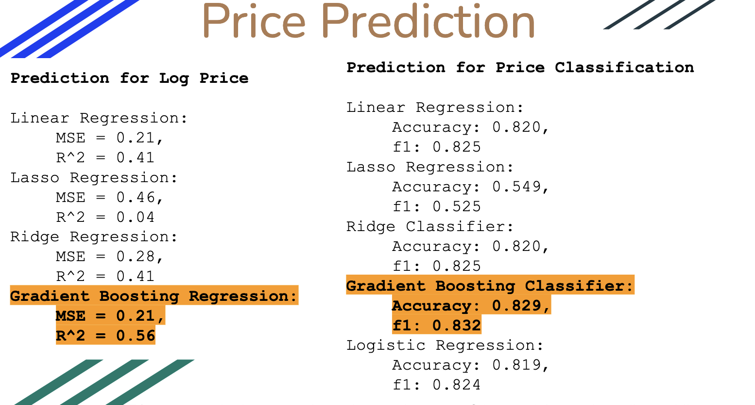
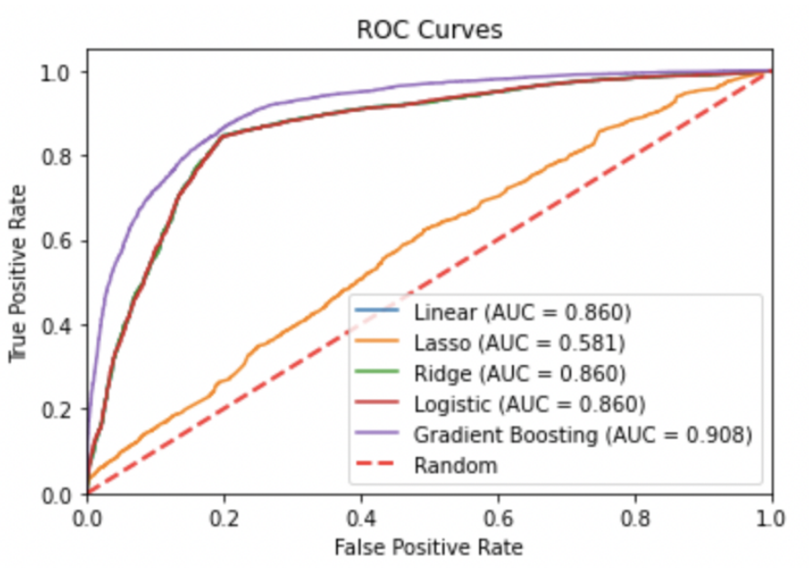
It is not enough to only look at the accuracy and F1 score, the ROC and AUC provide a more valuable comparison between the models.
Missing rating score for review of renting, this lead us to a delima in popularity examination. Since the review frequency can not fully represent the satisfaction of customer. Thus, we can not give useful recommendation for renting to customers.

Slide 4
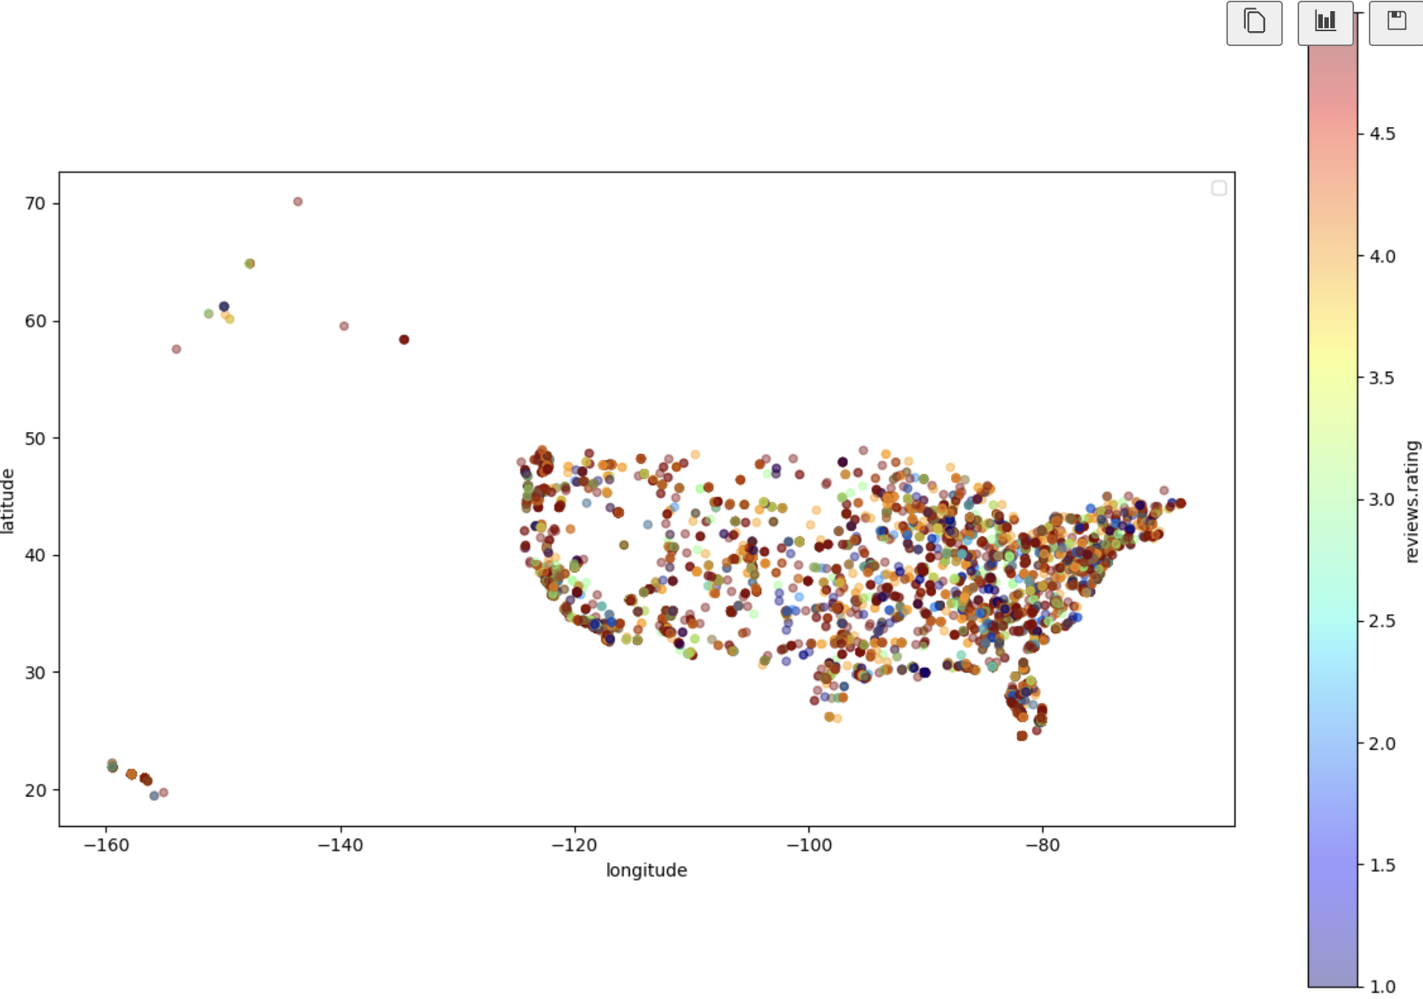
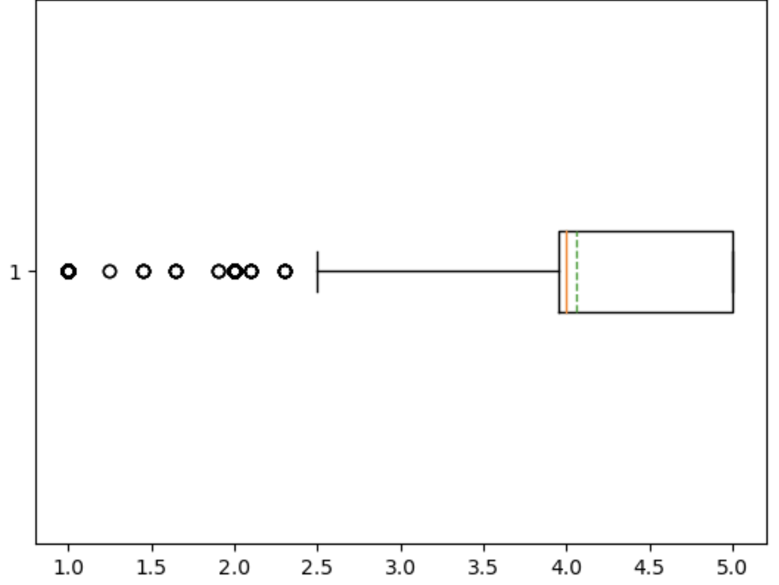
Hotel Review Data
count 20000.000000
mean 4.059183
std 1.157556
min 1.000000
25% 3.950000
50% 4.000000
75% 5.000000
max 5.000000
Biased review rating, people don’t like the hotel are less likely to give review.
Rating score is too discrete, fail to standardize.

Slide 5
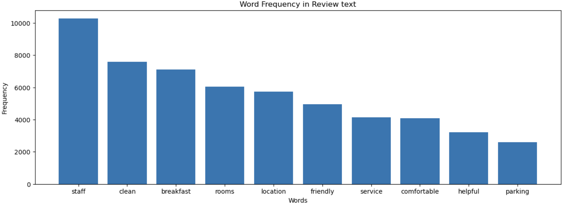
Things to Notice:
Since the there are more review with score 5, the frequence only shows which service/part of the hotel is more likely to satisfy the customers.

Slide 6
Sentiment Analysis
Sentiment analysis (or opinion mining) is a natural language processing (NLP) technique used to determine whether data is positive, negative or neutral. Sentiment analysis is often performed on textual data to help businesses monitor brand and product sentiment in customer feedback, and understand customer needs.
Sentiment analysis focuses on the polarity of a text (positive, negative, neutral) but it also goes beyond polarity to detect specific feelings and emotions (angry, happy, sad, etc), urgency (urgent, not urgent) and even intentions (interested v. not interested).

Slide 7
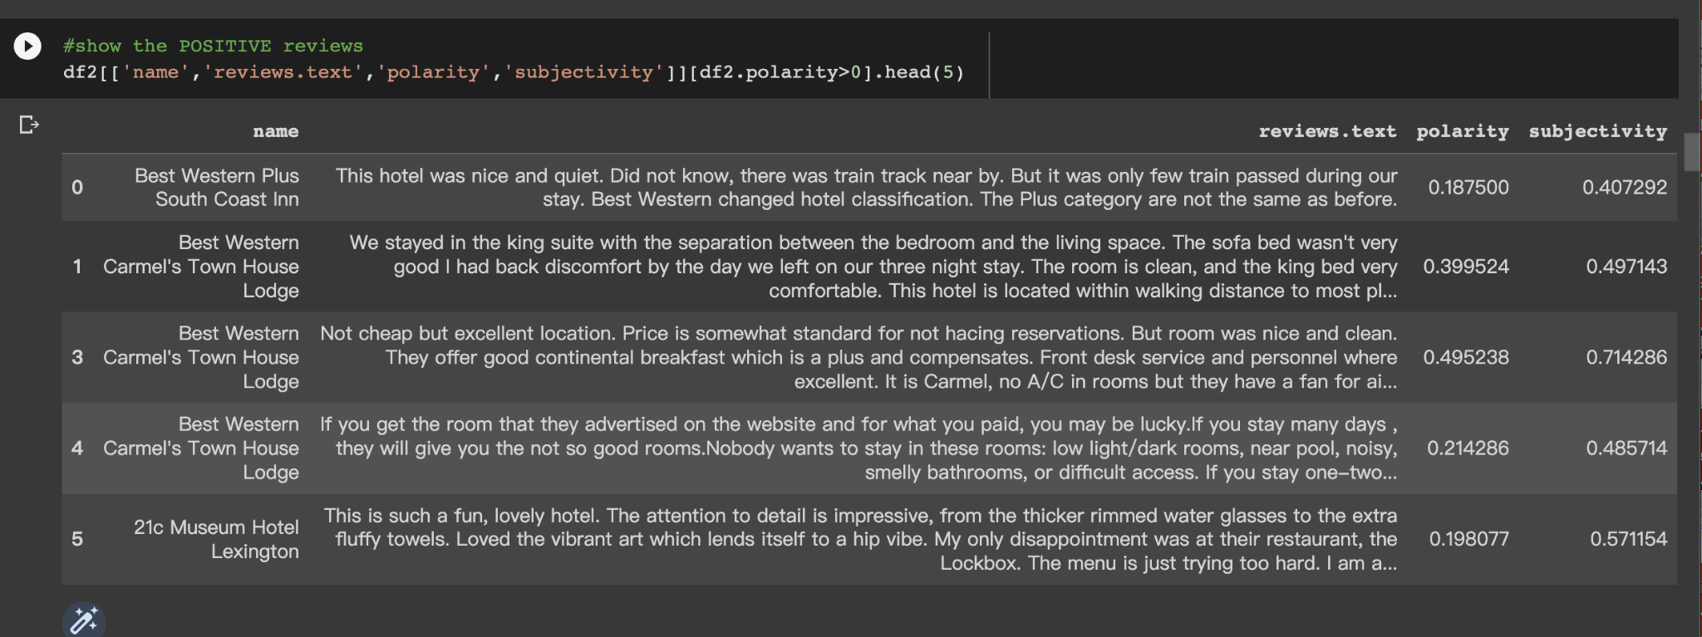
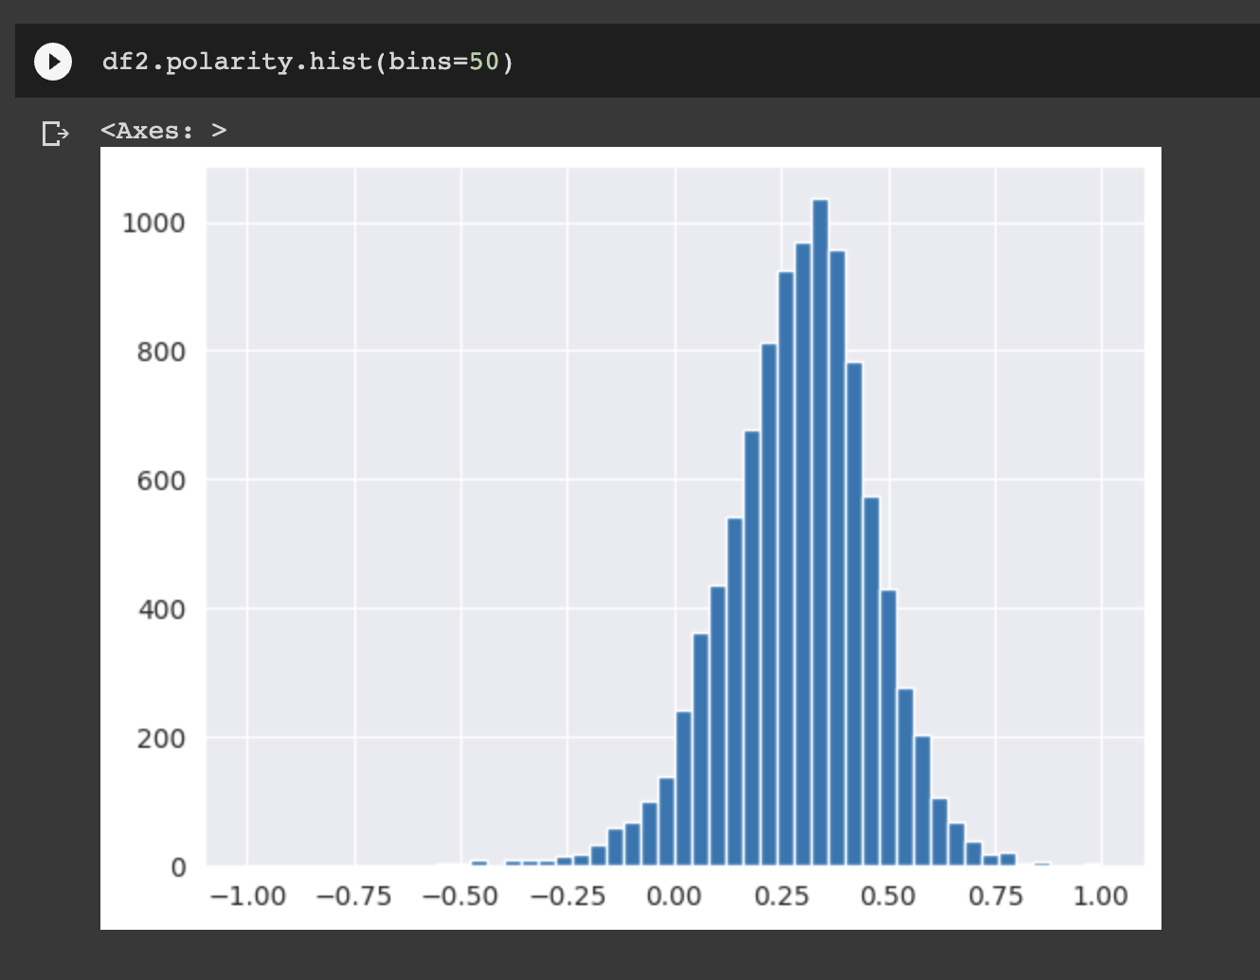
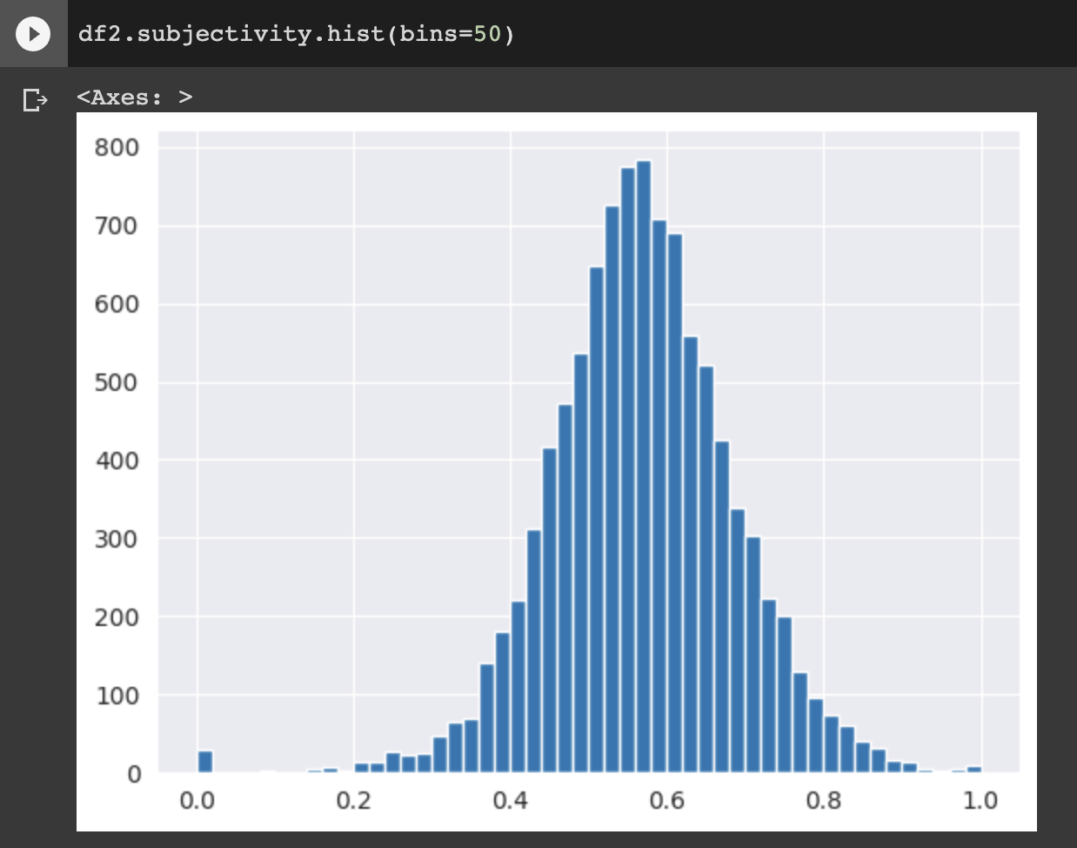
We utilize the TextBlob library of NLP to execute the sentiment analysis, and provide a polarity score between -1 and 1. Besides, we also create a subjective score to determine whether the review is objective or not.
These two plots shows how the polarity score and subjective score distribution look like; they both literally satisfy the Normal Distribution, which confirm the tendency that the best hotels and the worst hotels, they all account for very small percentage, not too good and not too bad is the majority.

Slide 8
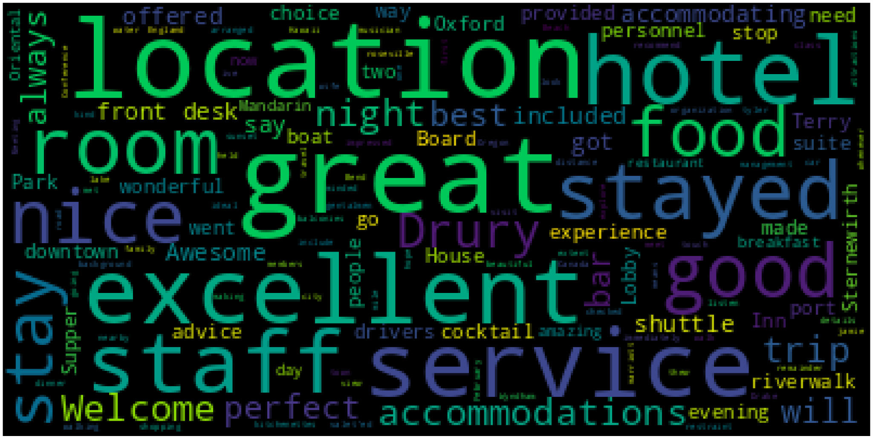
This plot from wordcloud describe the positive keywords in those positive reviews. They reflect during making decision, what kind of factors would people take into consideration, such as whether the service is good or not, where the location is, whether this hotel includes breakfast or not. Something like this.
Thus, we advise those ambitious hotel investors who want more customers and visitors could improve their service first, and besides, they also should make their location more competitive, because according to our heatmap early, we can find most hotels with higher rating scores located on both East and West coasts.

Slide 9
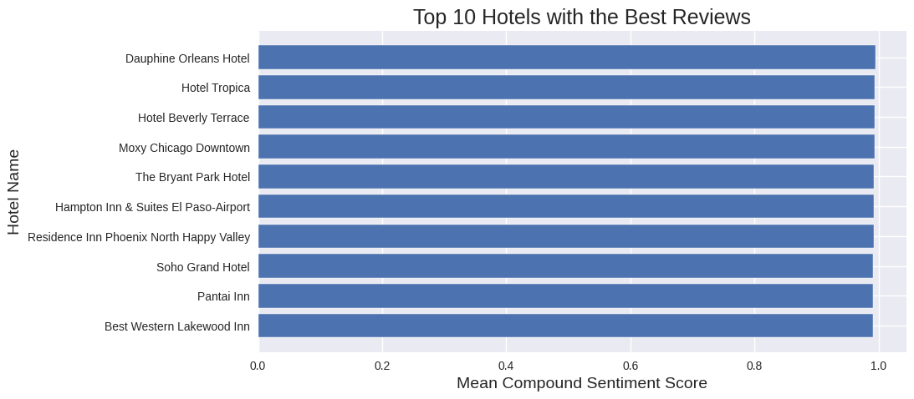
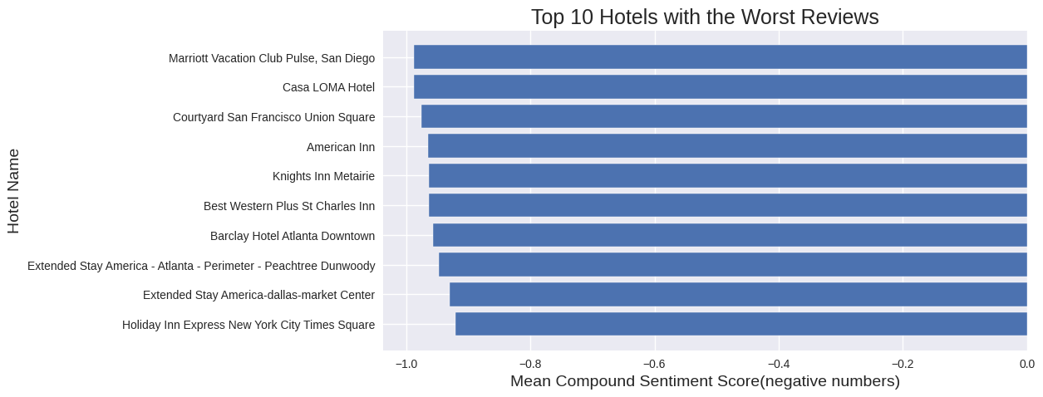
This is our top 10 best-recommendations
based on the hotel reviews
This is our top 10 worst-recommendation based on the hotel reviews

Slide 10
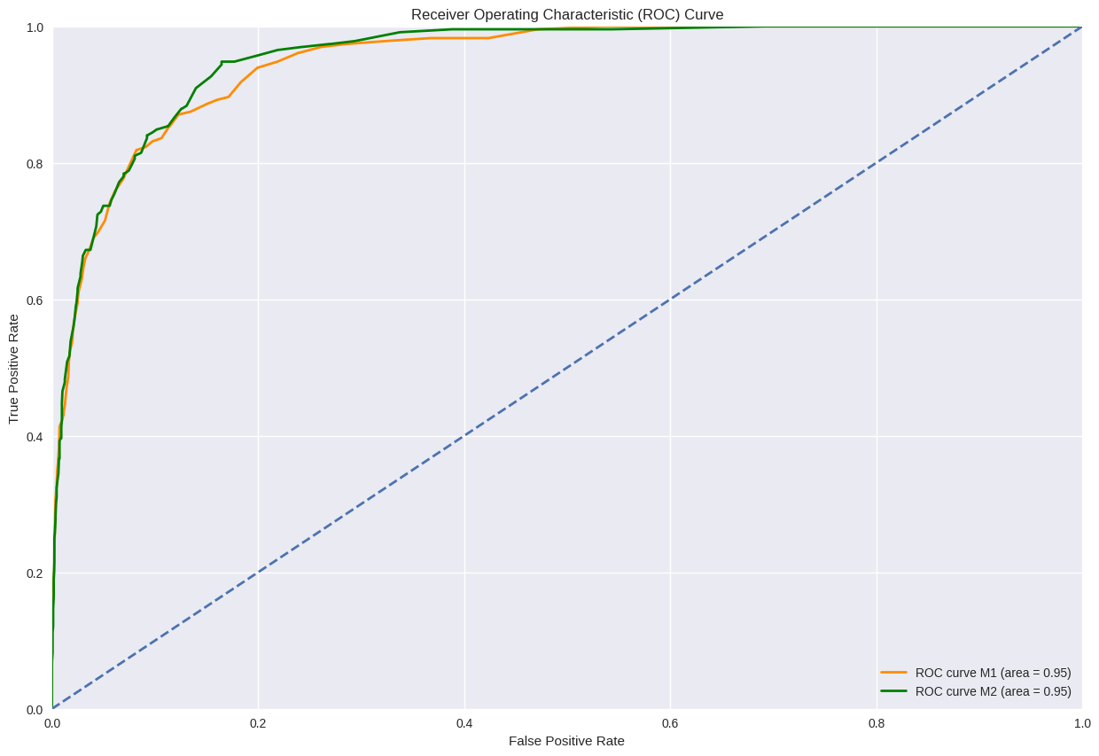
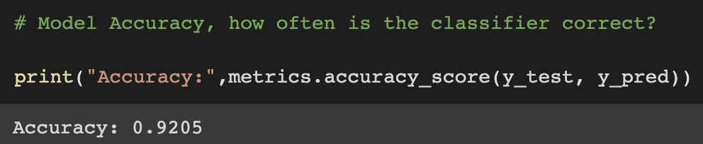
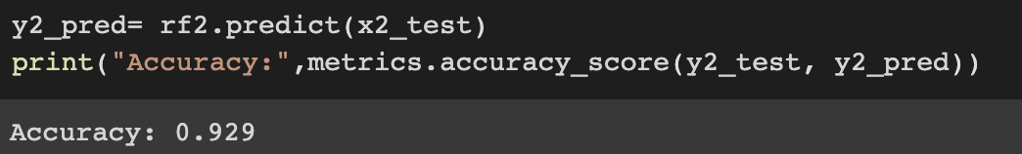
Model1: Word2vec to vectorize
Model2: BERT from Hugging face pre-trained model to vectorize

Slide 11
Two different approaches to find out the best vacation spot

Slide 12
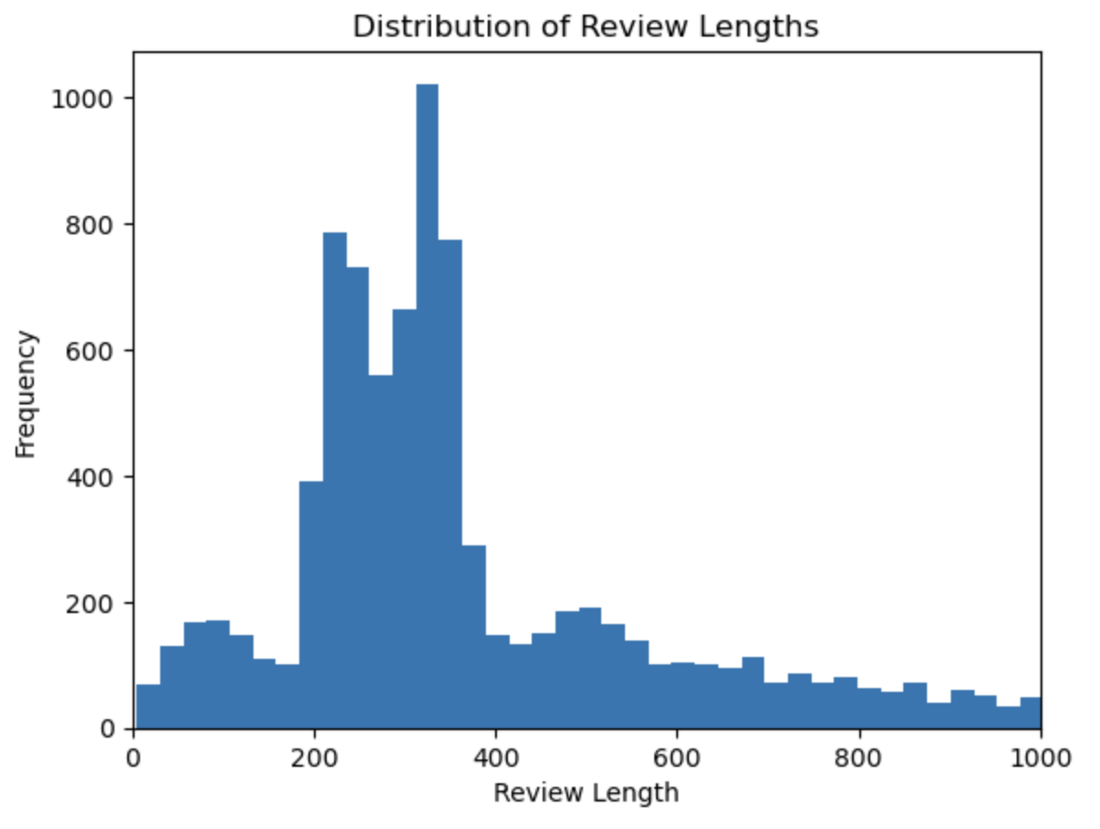
LDA generated topics
Review cleaning
Remove non-English reviews
Remove reviews shorter than 200 characters
Use 5-star reviews because we want to recommend using the good features

Slide 13
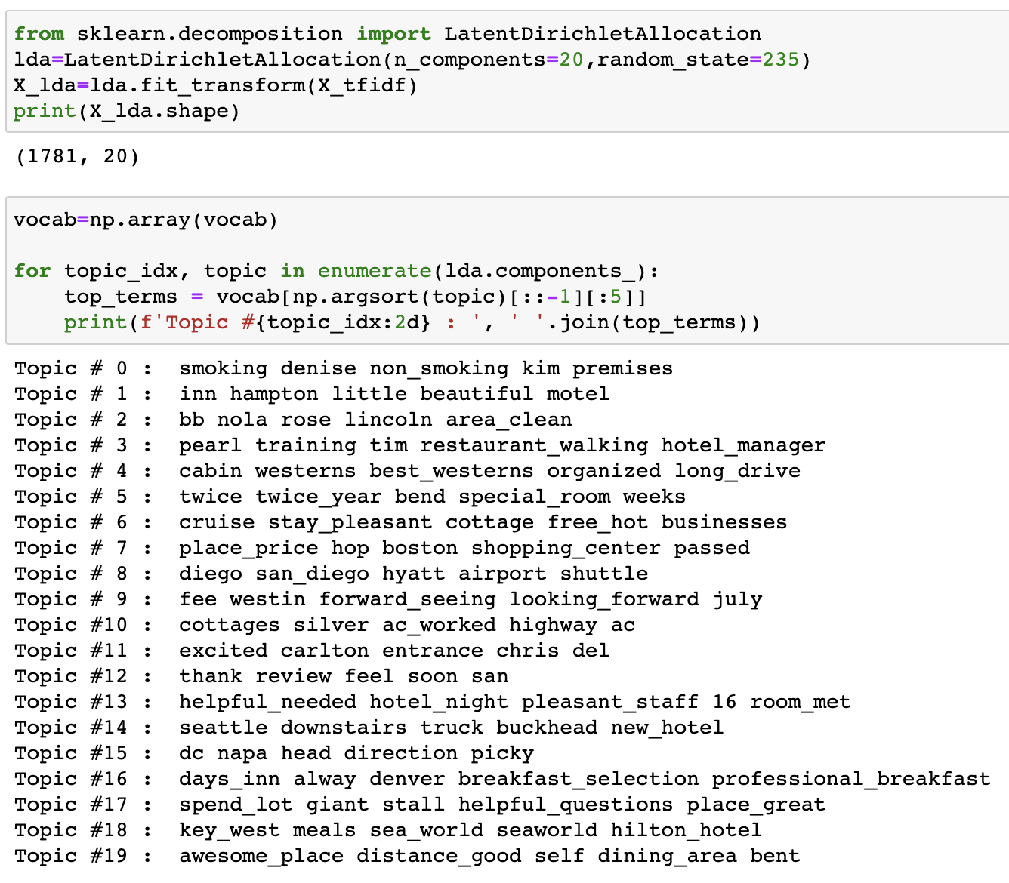
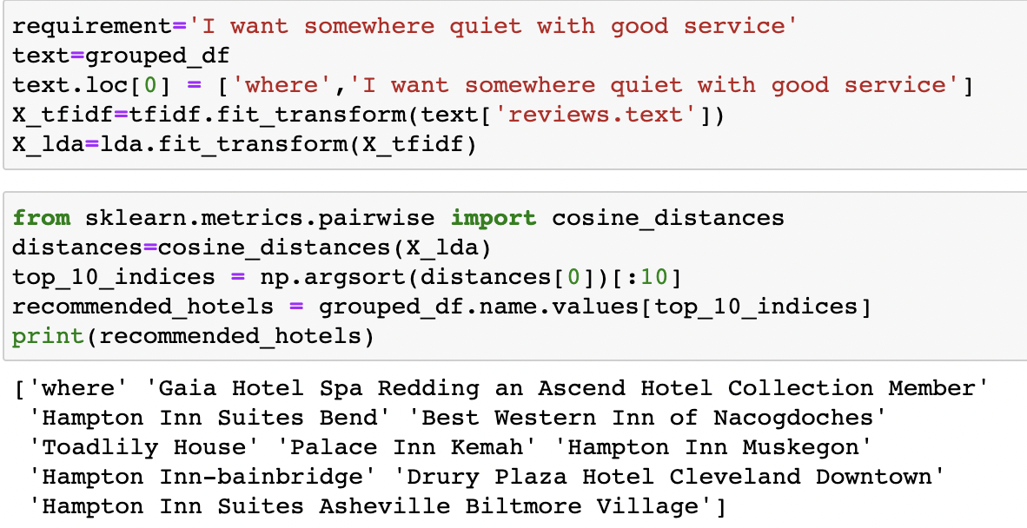
LDA generated topics
Based on the reviews of each hotel, we detect common topics (good features) mentioned in such hotel using LDA
Then generate hotel recommendations based on those topics

Slide 14
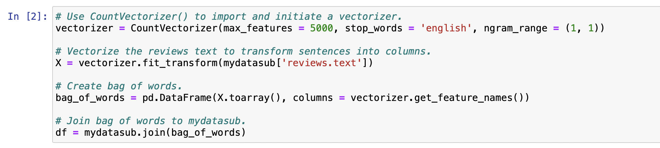
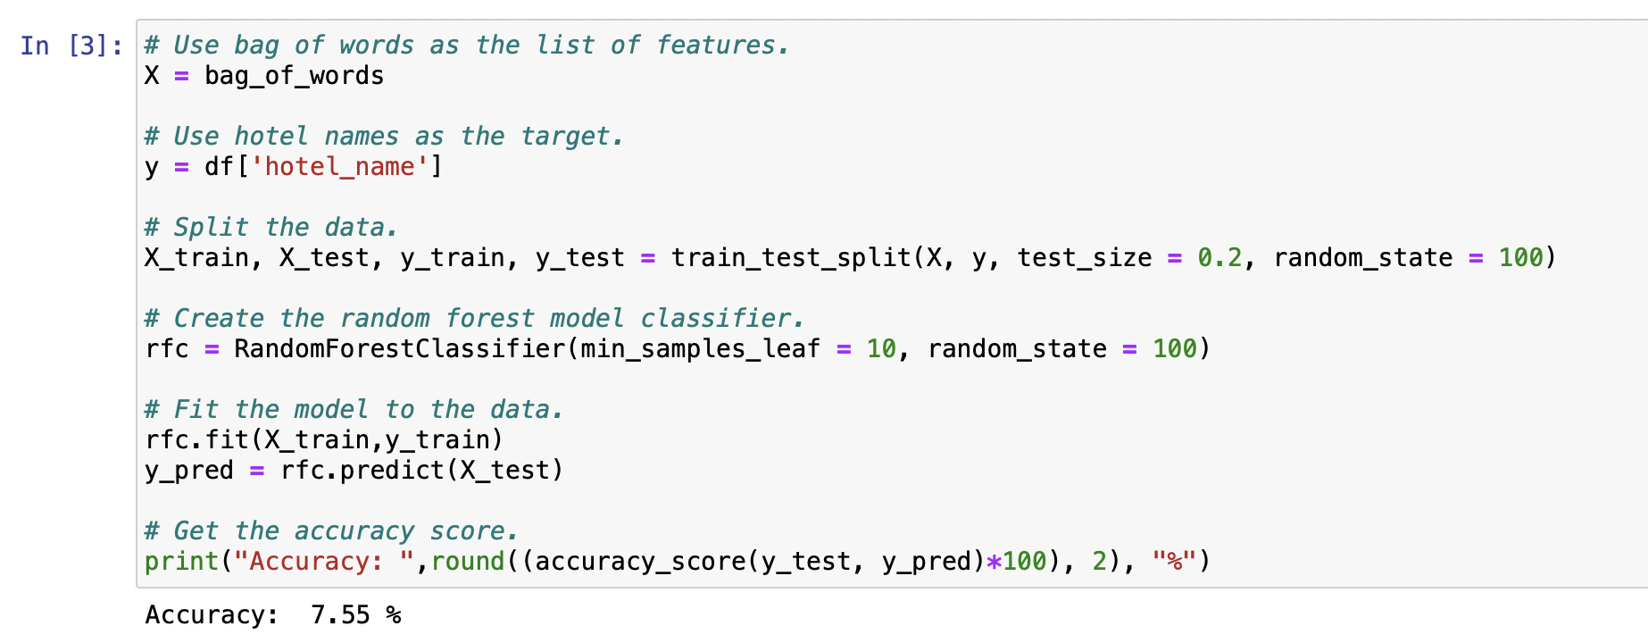
Going Deeper: Random Forest Classifier

Slide 15
Adjust the model for enhancing accuracy score
Use TfidfVectorizer instead of CountVectorizer
Give more importance to words that are specific to a document, making it more likely for the model to identify patterns that distinguish different documents (hotel reviews).
Incorporating additional features
One-Hot Encode categorical features.
Normalize numerical features.
Use GridSearchCV
Search for optimal values of the hyperparameters to improve the performance of the model.

Slide 16
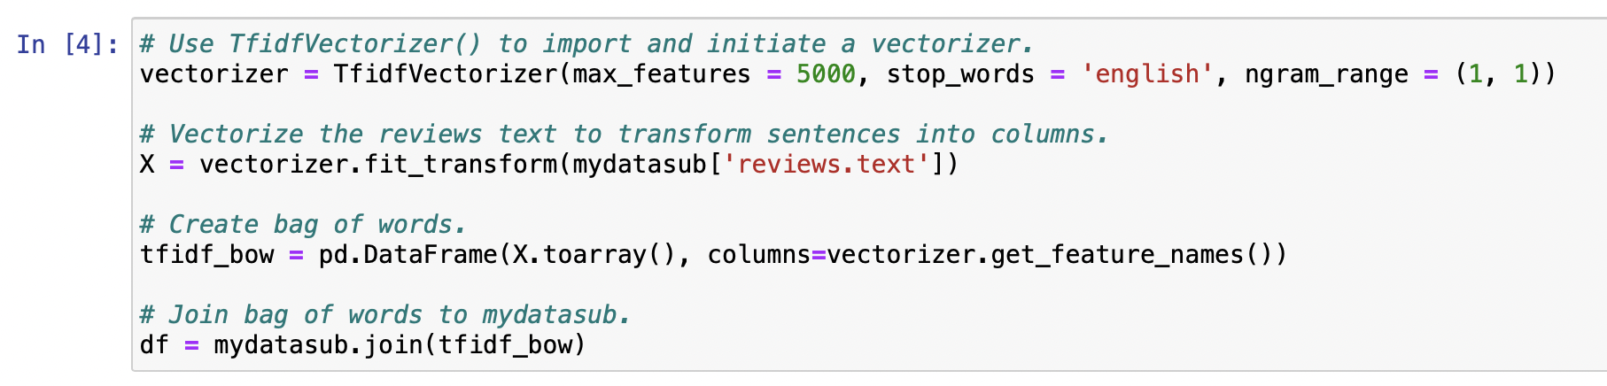
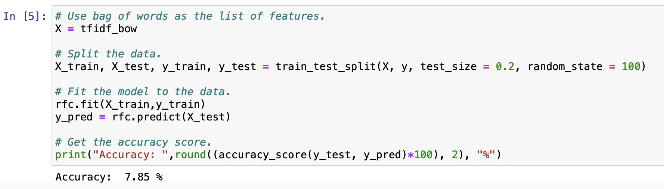
Use TfidfVectorizer instead of CountVectorizer

Slide 17
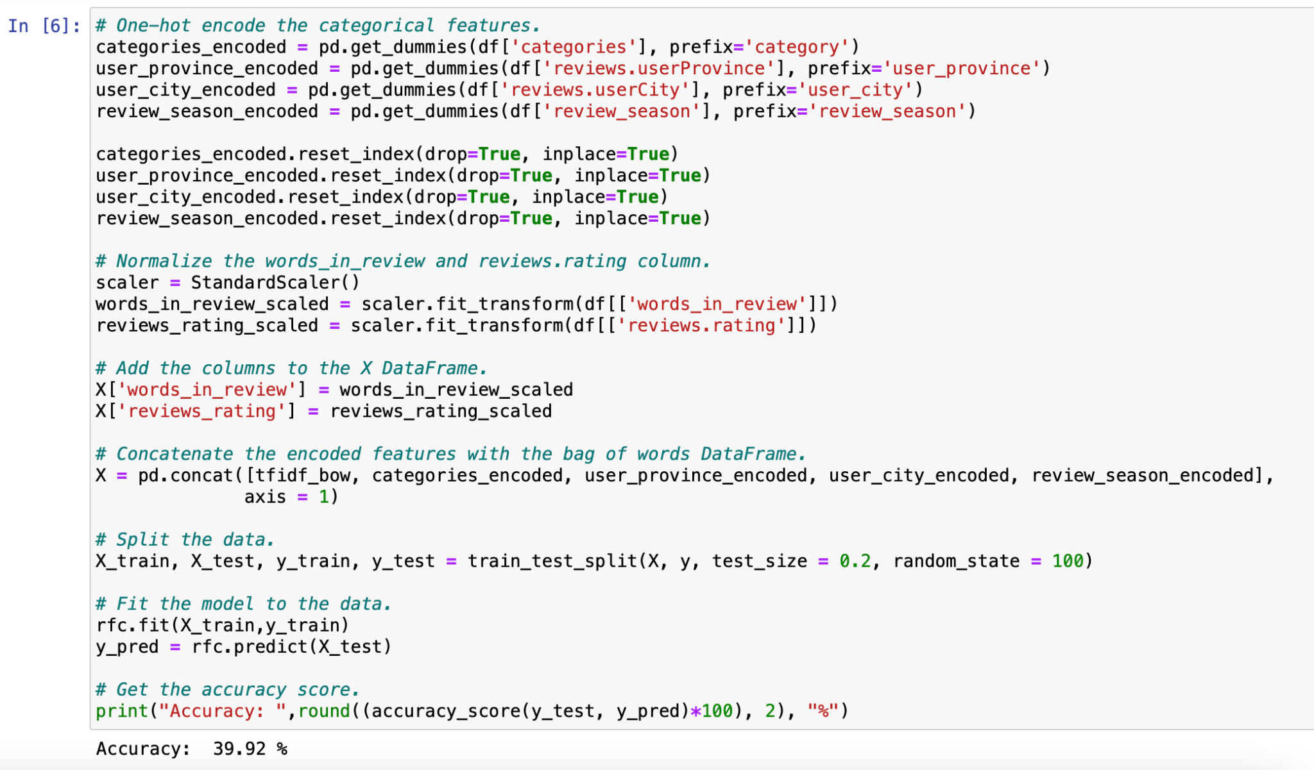
One-Hot Encode category features and normalize numerical features

Slide 18
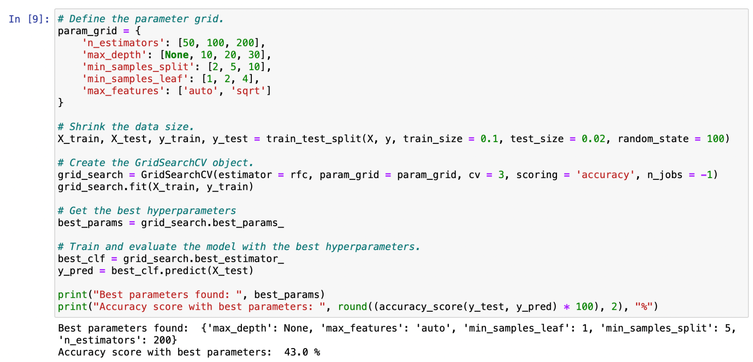
Use GridSearchCV to optimize hyperparameters

Slide 19
Evaluation & Interpretations
Low accuracy doesn’t mean bad recommendations since we’re using the exact hotel choices that customers made in the past as y_test
Our recommendation may outperform the customers’ original choice
If customers prefer to choose from a list of recommendations, we suggest the first LDA model.
If customers want a recommendation with a better accuracy, we suggest the second random forest model.

Slide 20
Business insights:
Limitations:
We suggest hotel platforms to recommend hotels based on seasons
Same as in Project 1, the hotel should pay attention to the keywords with high frequency. It will provide an efficient way for hotel to find the place to improve their services.
Based on the sentimental analysis, we advise hotels to improve their services (accommodations), and make their location more competitive. According to the heatmap, we find most hotels with higher rating scores locate on the East and West coasts.
Noisy data: the hotel reviews contain a lot of noise
If we have more low score ratings and reviews for hotel, we can use the same method to get the hotel’s drawbacks.
Bag-of-words approach ignores the order of words and their syntactic structure. This can limit the ability to capture more complex relationships between words and topics.
Even though we increase the accuracy to 40%, it still did not meet our expectations. It is hard to give prediction to a specific hotel, which is time consuming and expensive. (Need a powerful GPU!)

Slide 21
Thank you!

